Slide 1

11. STRING

Slide 2
SESSION OVERVIEW:
DEFINITION
CREATION
ACCESS & SLICING
CHANGING & DELETION
METHODS & BUILT-IN FUNCTIONS
OPERATIONS
ESCAPE SEQUENCES
FORMAT()

Slide 3

DEFINITION
A String is a Sequence or a Collections of Characters.
A String can be created by placing the characters within single, double, triple Quotes.
SYNTAX :
<variable_name> = ‘element1,element2,…..’

Slide 4


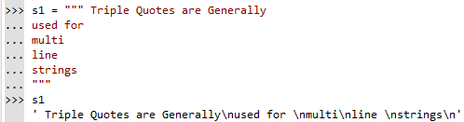

Slide 5
ACCESSING
We Use the Index Operator [ ] to access an element in the String.
Index Starts From 0
A String Having 5 Elements will have the Index from 0 to 4.
Slicing operator (:) – To Access a Range of Items in a Strings
A = | A | P | P | L | E
POSITIVE | 0 | 1 | 2 | 3 | 4
NEGATIVE | -5 | -4 | -3 | -2 | -1

Slide 6


ERRORS !
Index Error : Trying to Access an Element out of the Range
Type Error : Index Value Other than Integer

Slide 7
CHANGING VALUES
In Python, the Strings are Immutable, which means they cannot be changed.
A String element or range of elements can be changed or altered by using Reassignment
As Discussed above , We Cannot change the Elements in a Strings. That also Means
we cannot Delete or Remove items From a String.
But Deleting Entire String is Possible by Using ‘del’ keyword

Slide 8
OPERATIONS
Repetition & Concatenation
Membership Test
Iteration

Slide 9


ESCAPE SEQUENCES
An Escape Sequence starts with a Back Slash and is Interpreted Differently.
Not possible in Interactive Mode.

Slide 10
RAW STRINGS
Sometimes We like to Ignore the Escape Sequences inside a string.
We use ‘r/R’ before the Quotes

Slide 11
FORMAT METHOD
Default Order
Positional Argument
Keyword Argument
Binary Representation
Exponent Representation
Round off
String Alignment

Slide 12
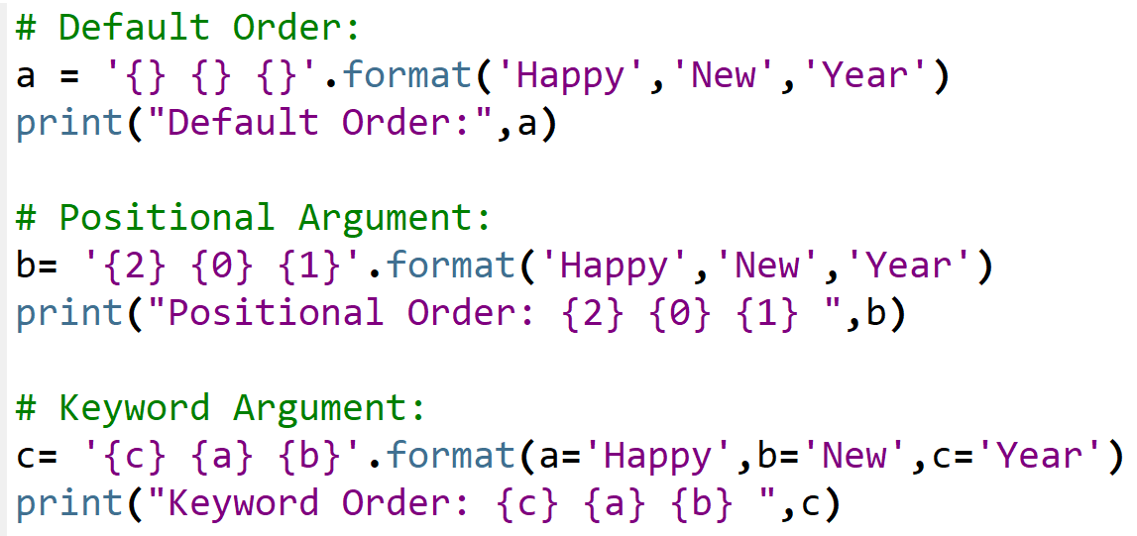

Slide 13

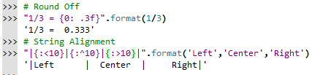

Slide 14
METHODS
In Python, There are 45 String Methods in Python 8.3 Version
We have 21 String Methods
The Built in Functions that works with Sequences works with Strings too.

Slide 15

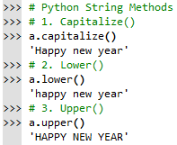

Slide 16
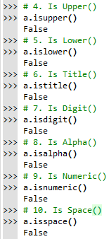
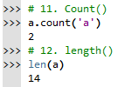
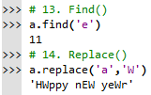
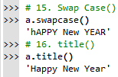

Slide 17

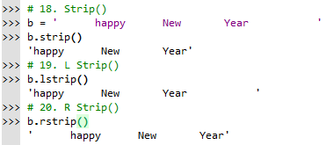
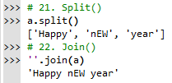

Slide 18

CODING IS FUN ! THANK YOU !!

